Slide 1
Learning Objective
I will be able to recognise graphs of derivative function
Success Criteria
At the end of the lesson, I will be able to:
Recognise graphs of derivative function
Sketch graphs of derivative functions

Slide 2




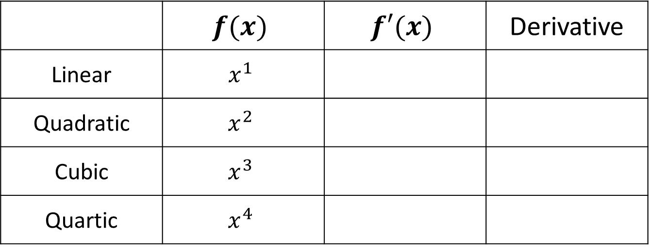
Rules of Derivative
Concept Development
 | $$f(x)$$ | $$f′(x)$$ | Derivative
Linear | $$x^{1}$$
Quadratic | $$x^{2}$$
Cubic | $$x^{3}$$
Quartic | $$x^{4}$$
$$1$$
Constant
$$2x$$
Linear
$$3x^{2}$$
Quadratic
$$4x^{3}$$
Cubic

Slide 3
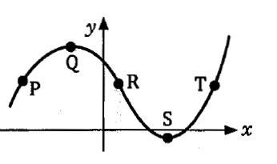
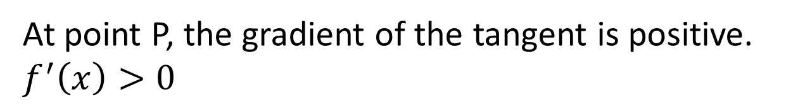

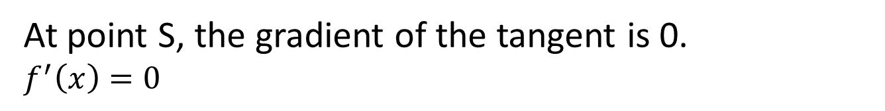
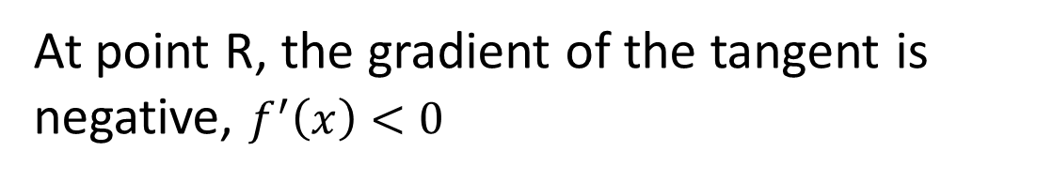
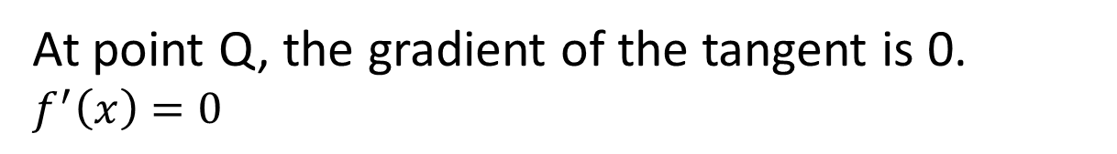
Concept Development
Consider the graph and determine the positive or negative nature of the gradient of the curve at points, P, Q, R, S, T
At point P, the gradient of the tangent is positive. $f^{′}\left(x\right)>0$
At point Q, the gradient of the tangent is 0.
$f^{′}\left(x\right)=0$
At point R, the gradient of the tangent is negative, $f^{′}\left(x\right)<0$
At point S, the gradient of the tangent is 0.
$f^{′}\left(x\right)=0$
At point T, the gradient of the tangent is positive
$$f^{′}\left(x\right)>0$$

Slide 4
Concept Development
If $f^{′}\left(x\right)>0$, for all x in the interval $⇒$ the function is strictly increasing
If $f^{′}\left(x\right)<0$ for all x in the interval $⇒$ the function is strictly decreasing
If $f^{′}\left(x\right)=0⇒$ there exist a minimum or maximum turning point

Slide 5
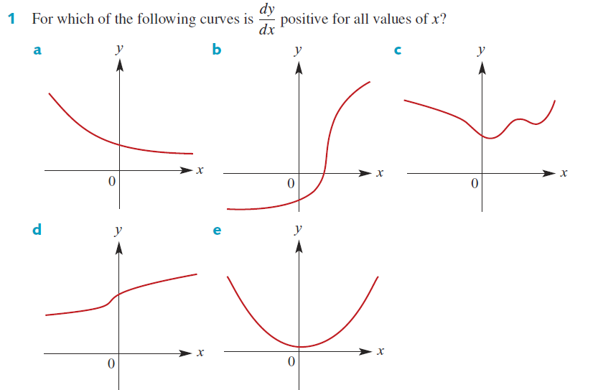
Guided Practice

Slide 6
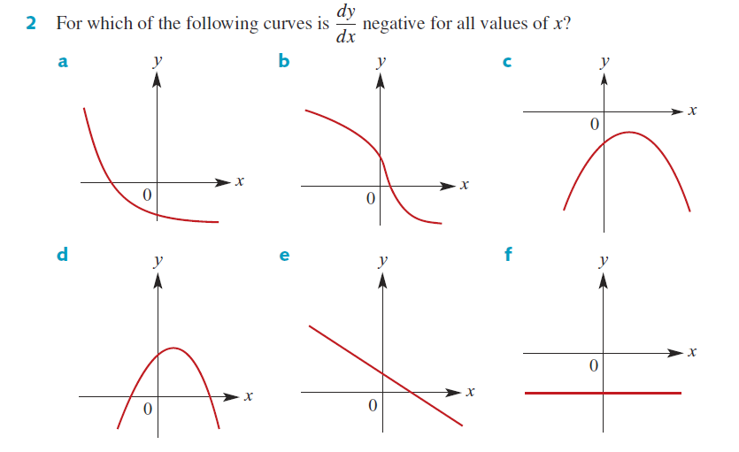
Guided Practice

Slide 7
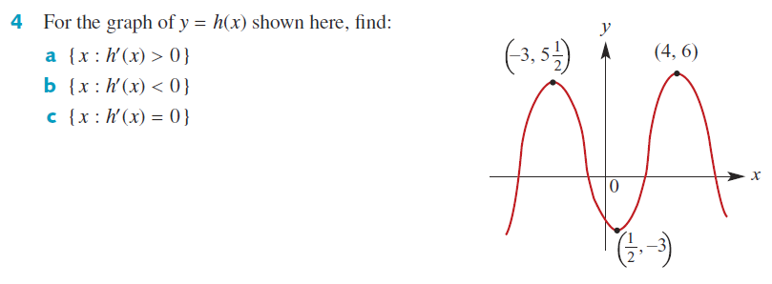
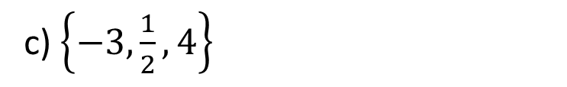
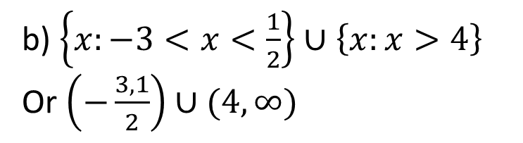
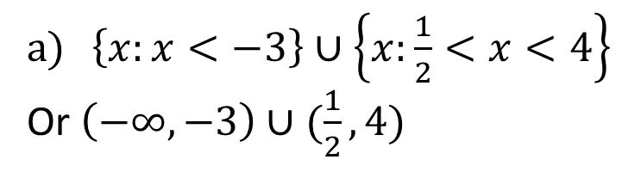
Guided Practice
$\left\{x:x<−3\right\}∪\left\{x:\frac{1}{2}<x<4\right\}$
Or $\left(−∞,−3\right)∪(\frac{1}{2},4)$
b) $\left\{x:−3<x<\frac{1}{2}\right\}∪\left\{x:x>4\right\}$
Or $\left(−\frac{3,1}{2}\right)∪(4,∞)$
c) $\left\{−3,\frac{1}{2}, 4\right\}$

Slide 8
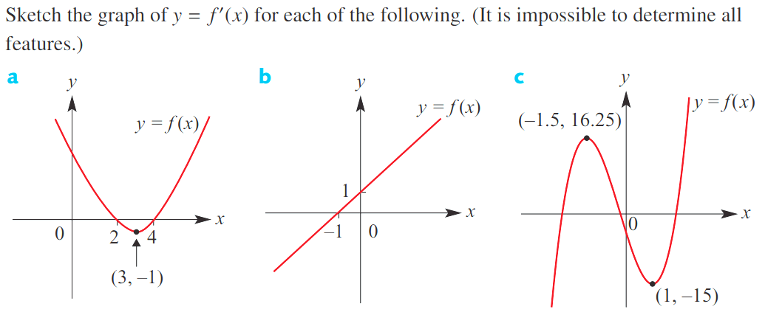


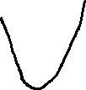
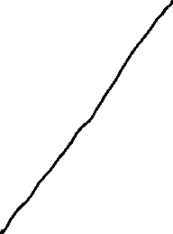
Guided Practice

Slide 9
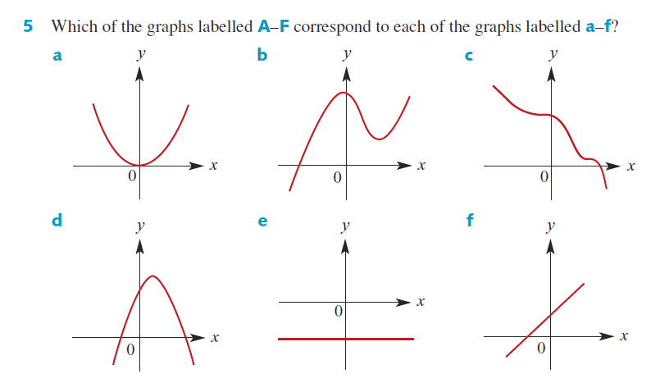
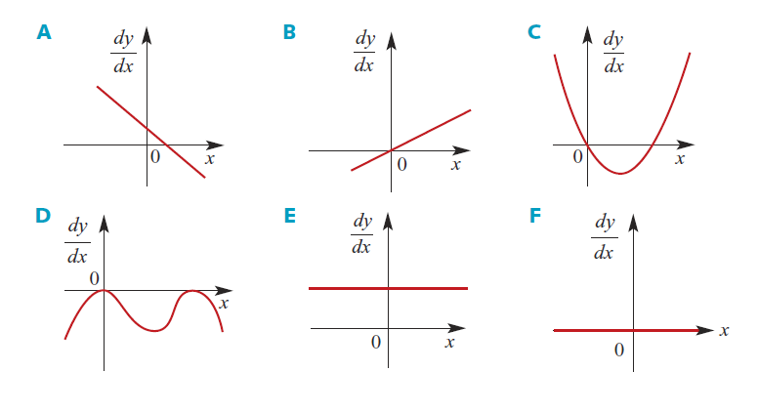
Guided Practice

Slide 10
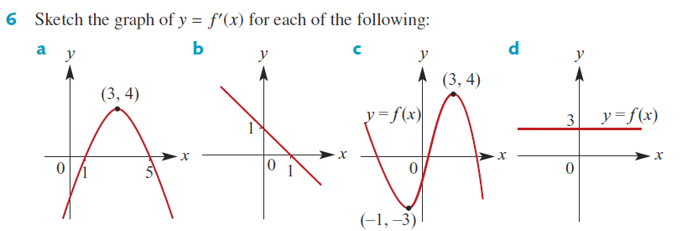
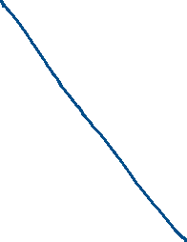

Guided Practice

Slide 11


Guided Practice

Slide 12
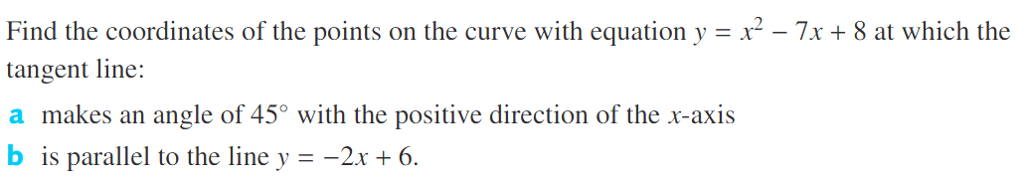



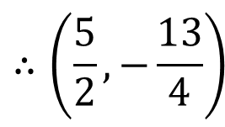




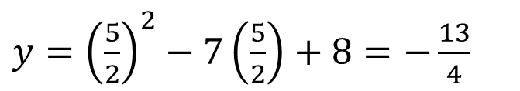


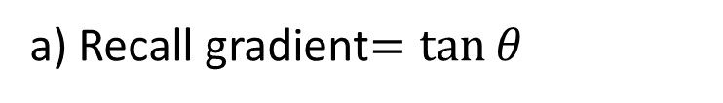


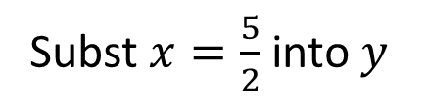

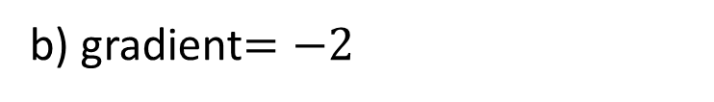
Guided Practice
b) gradient$=−2$
a) Recall gradient$=\tan{θ}$
$$\frac{dy}{dx}=2x−7$$
$∴$ gradient$=\tan{45°}=1$
$$\frac{dy}{dx}=2x−7$$
$$−2=2x−7$$
$$5=2x$$
$$1=2x−7$$
$$x=\frac{5}{2}$$
$$x=4$$
Subst $x=4$ into $y$
Subst $x=\frac{5}{2}$ into $y$
$y={\left(4\right)}^{2}−7\left(4\right)+8$
$y={\left(\frac{5}{2}\right)}^{2}−7\left(\frac{5}{2}\right)+8=−\frac{13}{4}$
$$y=−4$$
$$∴\left(\frac{5}{2},−\frac{13}{4}\right)$$
$$∴(4,−4)$$

Slide 13
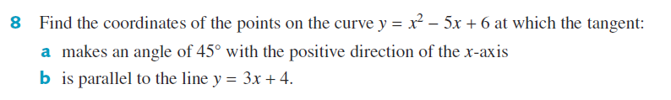

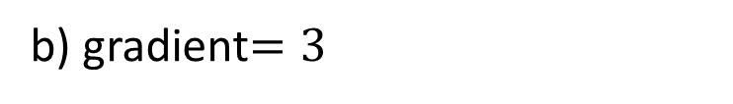




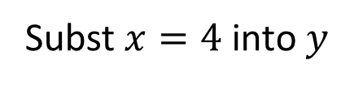






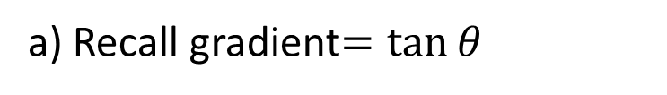


Guided Practice
a) Recall gradient$=\tan{θ}$
b) gradient$=3$
$∴$ gradient$=\tan{45°}=1$
$$3=2x−5$$
$$\frac{dy}{dx}=2x−5$$
$$x=4$$
$$1=2x−5$$
Subst $x=4$ into $y$
$$x=3$$
$y={\left(4\right)}^{2}−5\left(4\right)+6$
Subst $x=3$ into $y$
$$y=2$$
$y={\left(3\right)}^{2}−5\left(3\right)+6$
$$∴(4,2)$$
$y=0$
$$∴(3,0)$$

Slide 14

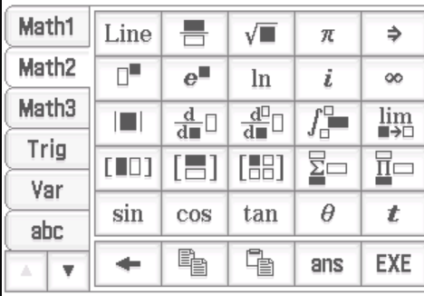
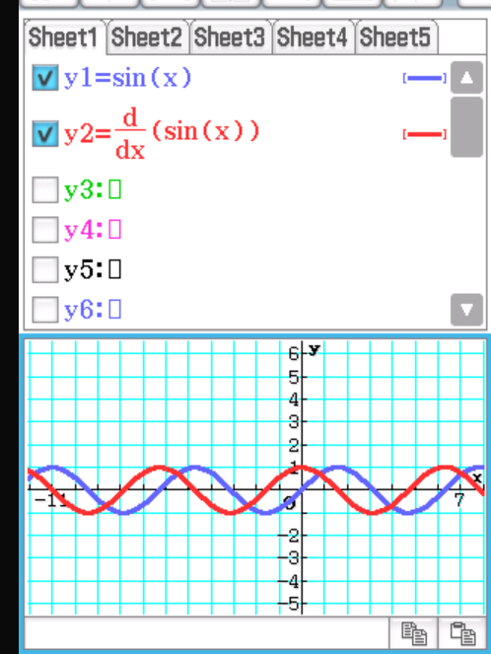
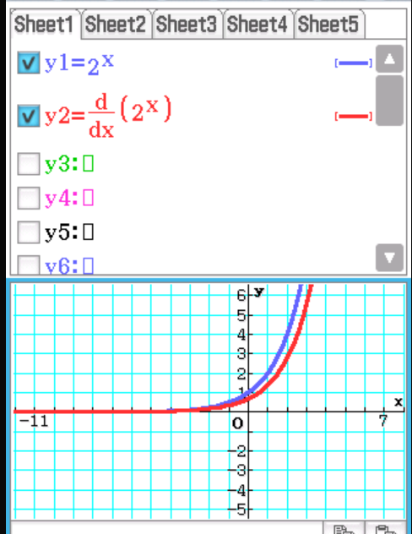


Guided Practice

Slide 15
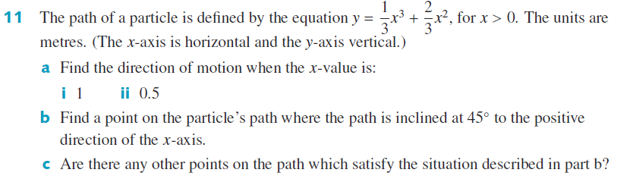
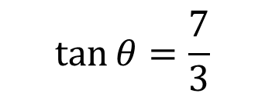
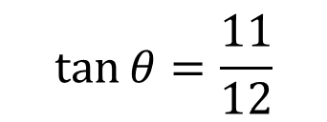
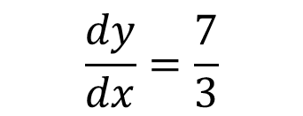

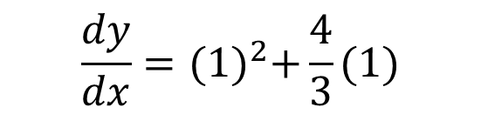
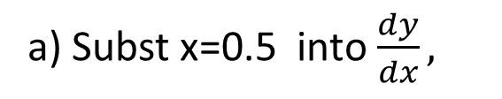
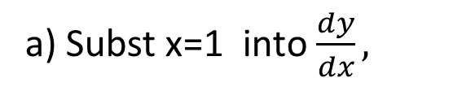
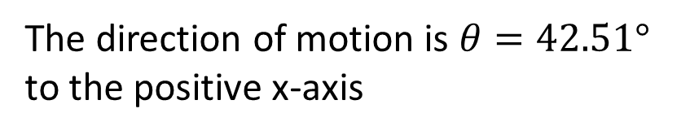
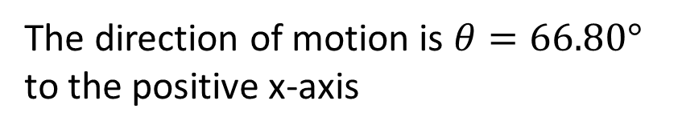
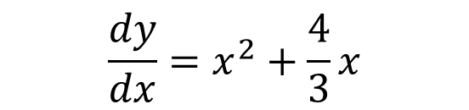


Guided Practice
$$\frac{dy}{dx}=x^{2}+\frac{4}{3}x$$
a) Subst x=1 into $\frac{dy}{dx},$
a) Subst x=0.5 into $\frac{dy}{dx},$
$$\frac{dy}{dx}={(1)}^{2}+\frac{4}{3}(1)$$
$$\frac{dy}{dx}=\frac{11}{12}$$
$$\frac{dy}{dx}=\frac{7}{3}$$
$$\tan{θ}=\frac{11}{12}$$
$$\tan{θ}=\frac{7}{3}$$
$$θ=42.51°$$
$$θ=66.80°$$
The direction of motion is $θ=42.51°$ to the positive x-axis
The direction of motion is $θ=66.80°$ to the positive x-axis

Slide 16





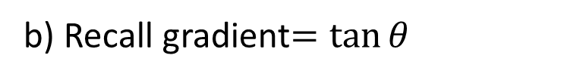

Guided Practice
$$\frac{dy}{dx}=x^{2}+\frac{4}{3}x$$
b) Recall gradient$=\tan{θ}$
$∴$ gradient$=\tan{45°}=1$
$$1=x^{2}+\frac{4}{3}x$$
$$x=0.535, x=−1.86$$
$$(not possible because x>0)$$
Subst. $x=0.535 into y$
$$y=0.242$$
$$(0.535, 0.242)$$
c) No because $x>0,$ path needs to be positive.

Slide 17
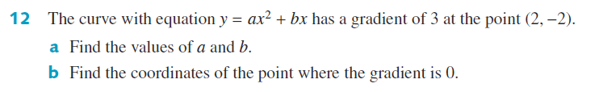



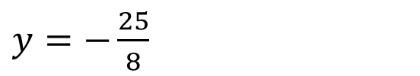



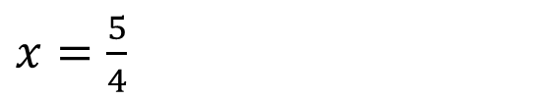



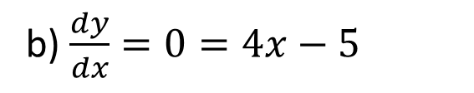



Guided Practice
$$y=ax^{2}+bx$$
Subst. (2, -2) into $y$
$$4a=8$$
$$−2=4a+2b −−(1)$$
$$a=2$$
$$\frac{dy}{dx}=2ax+b$$
b) $\frac{dy}{dx}=0=4x−5$
$x=\frac{5}{4}$
Subst. $\frac{dy}{dx}=3, x=2$ into$\frac{dy}{dx}$
$y=−\frac{25}{8}$
$$3=4a+b −−(2)$$
$$\left(1\right)−\left(2\right), b=−5$$
$$\left(\frac{5}{4}, −\frac{25}{8}\right)$$
$$subst b=−5 into (1)$$
$$−2=4a+2(−5)$$

Slide 18
Independent Practice
Complete Cambridge Ex 17F

